Slide 1

CatBoost: Gradient Boosting for data with both numerical and text features
Anna Veronika Dorogush, Head of CatBoost team
Notes:
Представление

Slide 2


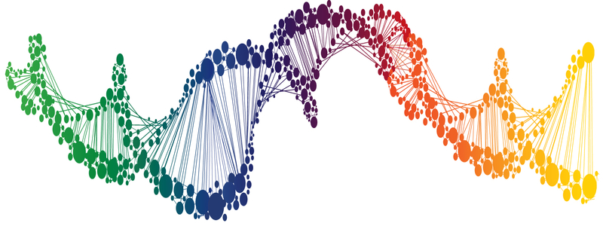

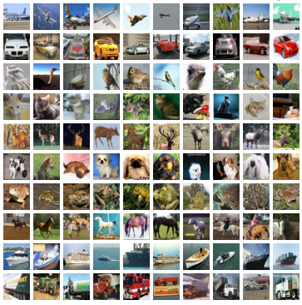
Applied ML (supervised learning)
Applications
Data at hand
Tool
DNA
Text
Linear models
Neural nets
Decision trees
GBDT
etc
Medicine
Finance
+
+
Sales prediction
Images
Music
Notes:
CatBoost is a library that solves supervised learning task
Here on a slide is a rough illustration of what supervised learning consist of of:
we have some application where we want to apply ML techniques
We have some data at hand, that could be used to solve our problem. This data contains samples and for each samples we have associated label. The task is to predict label based on sample in some optimal way. Applications defines what the optimal way is. And to predict in this optimal way we optimise some loss function, that, directly or indirectly, search for optimal model
Finally, we have bunch of libraries that could be used to solve the problem
This libraries, usually, generalise well for different applications. Linear models, GBDT, Decision tress — all this could be used for different types of predictions problems: classification, regression, ranking — just select the proper loss function
But, different tools work well with different data
For examples, for images CNN are the best choice
For speech recognition recurrent neural networks provides great results

Slide 3
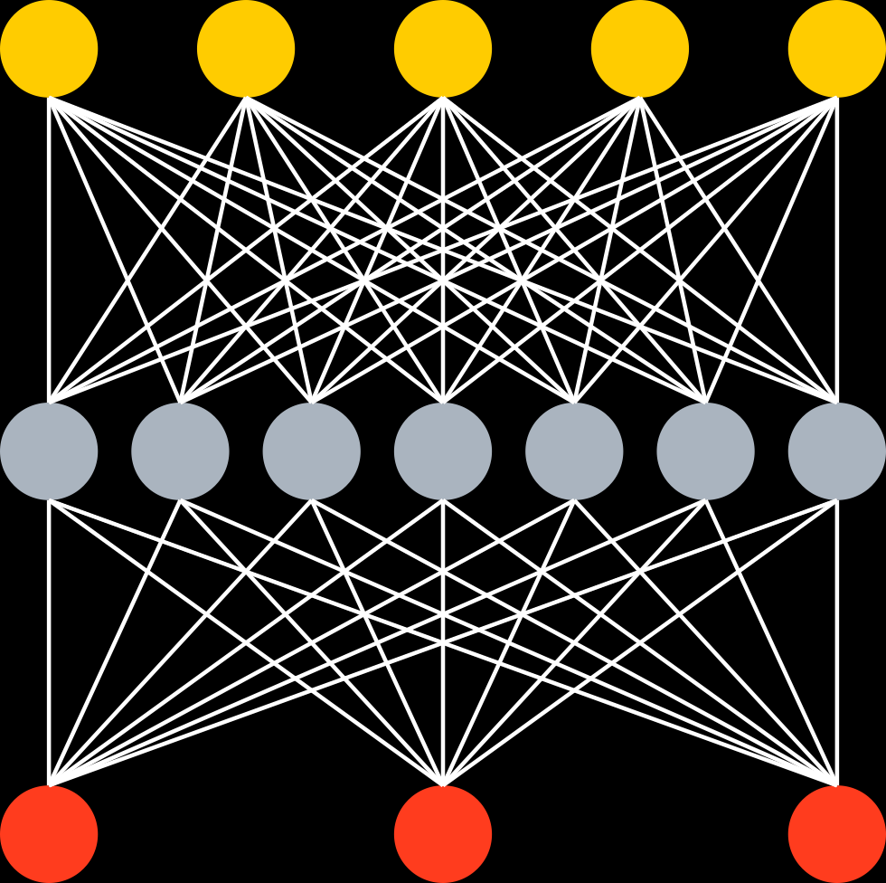
Data at hand
Tabular (or structured) data
Unstructured data
Well engineered features
^{Music track length} | ^{Year} | ^{Rating} | ^{Label}
² | ¹⁹⁹⁰ | ³ | ¹
³ | ¹⁹⁵⁰ | ⁵ | ⁰
¹⁵ | ¹⁹⁷⁰ | ⁴ | ¹
Music
DNA
Images
Text
End2End with Deep NN
GBDT
+
+
+
+
…
Big error
Better
Ship it
Notes:
Here you can seen one way to classify type of data used to solve practical problems today
Firstly, we have so-called unstructured data, like images, were deep learning techniques shows the great result
Secondly, we have tabular, or structured data: well-engineered features are used to describe sample we use to make predictions.Each sample is just a row of float numbers in table. Plus a label that we need to predict.
For this type of data the state-of-the-art results are achieve by GBDT
This is power technique that builds an ensemble, or linear combination, of decision trees. And builds it in a greedy way. Method starts with just one tree, this tree usually have big error and we iteratively and a new tree is learned to corrects errors performed by previous ones
This technique is very easy to use, that’s almost no parameter that need to be carefully tuned, like neural network architecture. For GBDT is’t often enough to use just 3 parameters: maximum depth of tree, number of trees you want to train and learning rate which is some kind of regularizations. And thats all, you could spend the rest of time working with the data, not the machine learning model. And dealing with the data is the most important part.
Gradient boosting works well on small datasets and could be scaled for big ones

Slide 4
Tabular data? Decision trees!
Animal?
No
Yes
Not a cat
Have whiskers?
No
Yes
Not a cat
Purrs?
No
Yes
Cat!
Not a cat

Slide 5
Gradient boosted decision trees
State-of-the-art quality on tabular data
Easy to use, no sophisticated parameter tuning
Works well with small data and scales for big data problems
+
+
+
+
…
Big error
Better
Ship it
Notes:
GBDT is powerful and easy-to-use technique, its

Slide 6
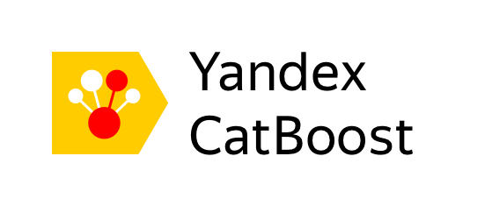


Main Boosting libraries
LightGBM
LightGBM
Notes:
Today we have several highly efficient implementation of this technique: XGBoost, CatBoost and LigthGBM

Slide 7
CatBoost advantages
Good quality with default parameters
Sophisticated categorical and text features support
Model analysis tools
Set of tools to make GBDT usage easier

Slide 8
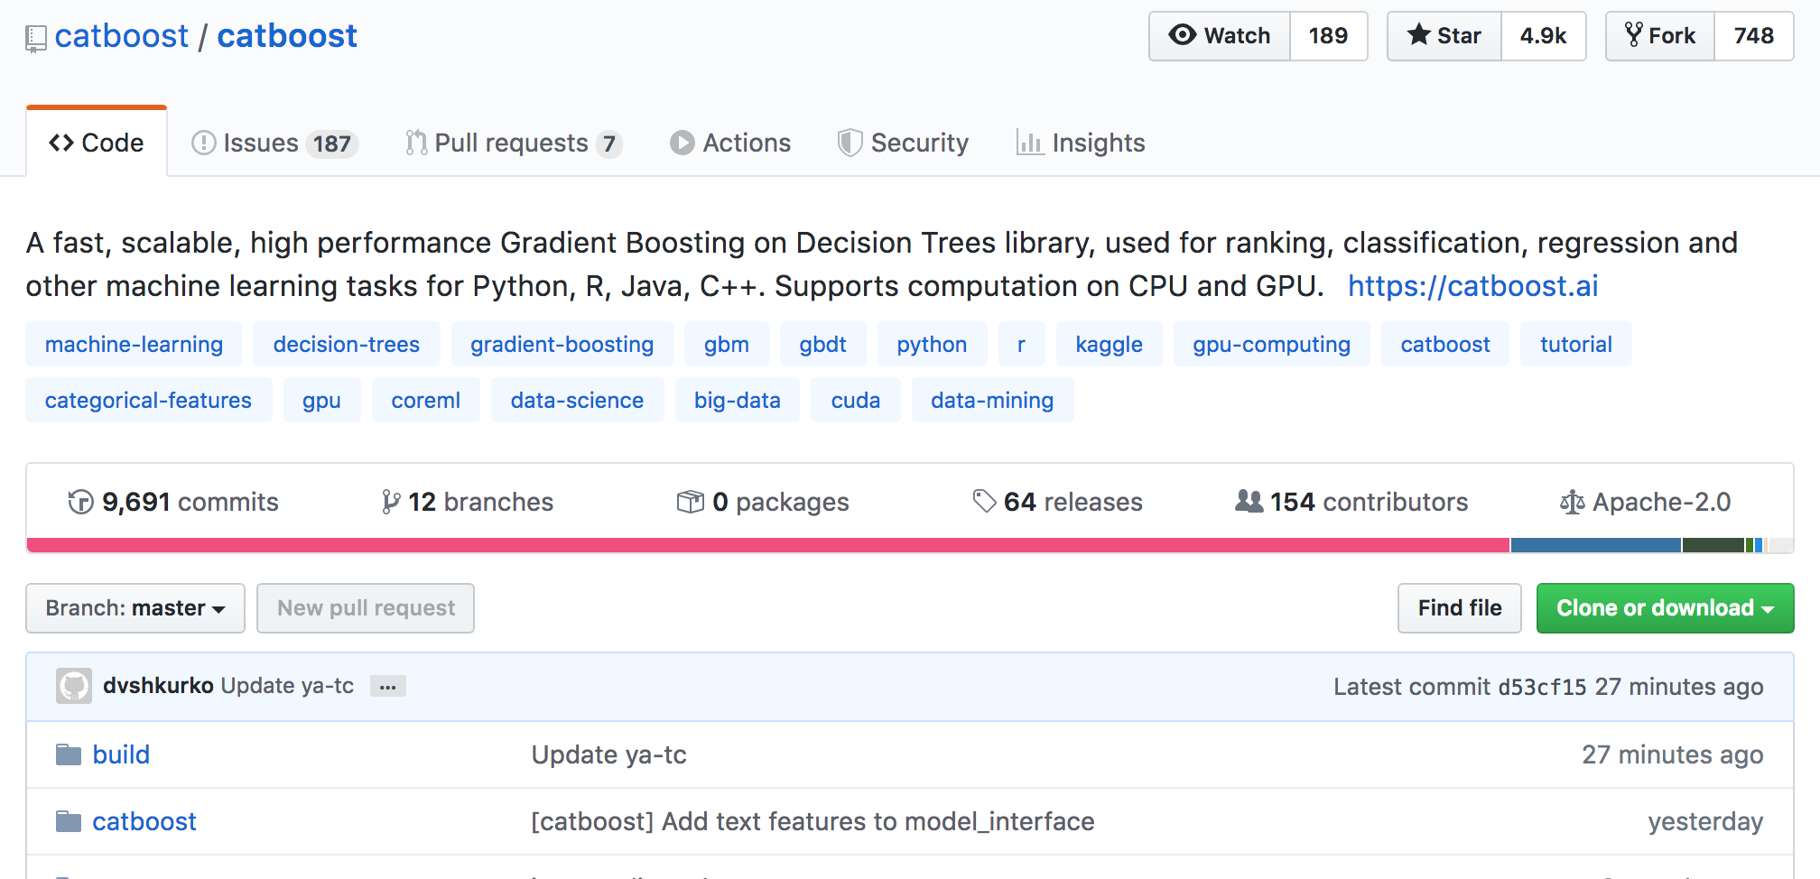
CatBoost
50K pip installs per week
4.9 stars on github
64 releases

Slide 9

CatBoost in Yandex
Yandex.Zen
Yandex.Music
Yandex.Self-Driving Cars
Yandex.Search
Yandex.Ads
Yandex.Weather
Yandex Alice
Practically everywhere!

Slide 10
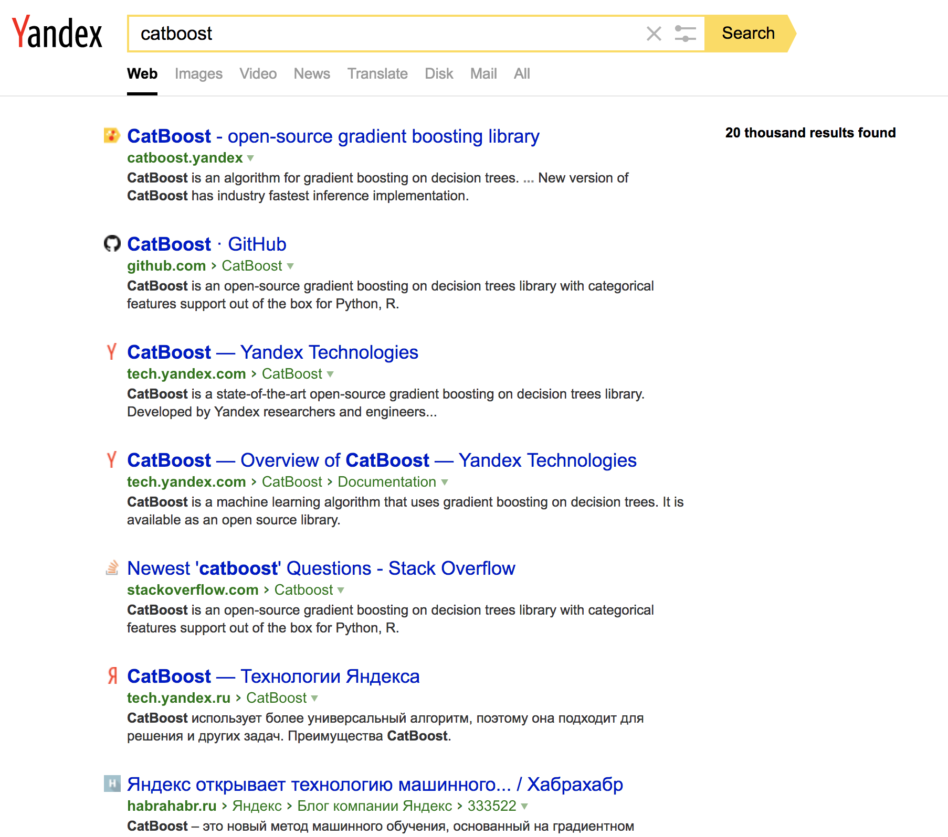
Yandex.Search
Task?
Search document order prediction
Task type: ranking
Dataset features:
Classic features (PageRank, BM25 and others)
Neural Networks output
CatBoost features used:
YetiRankPairwise target
Distributed GPU training
Model blending
Feature importance analysis
Ranking analysis

Slide 11
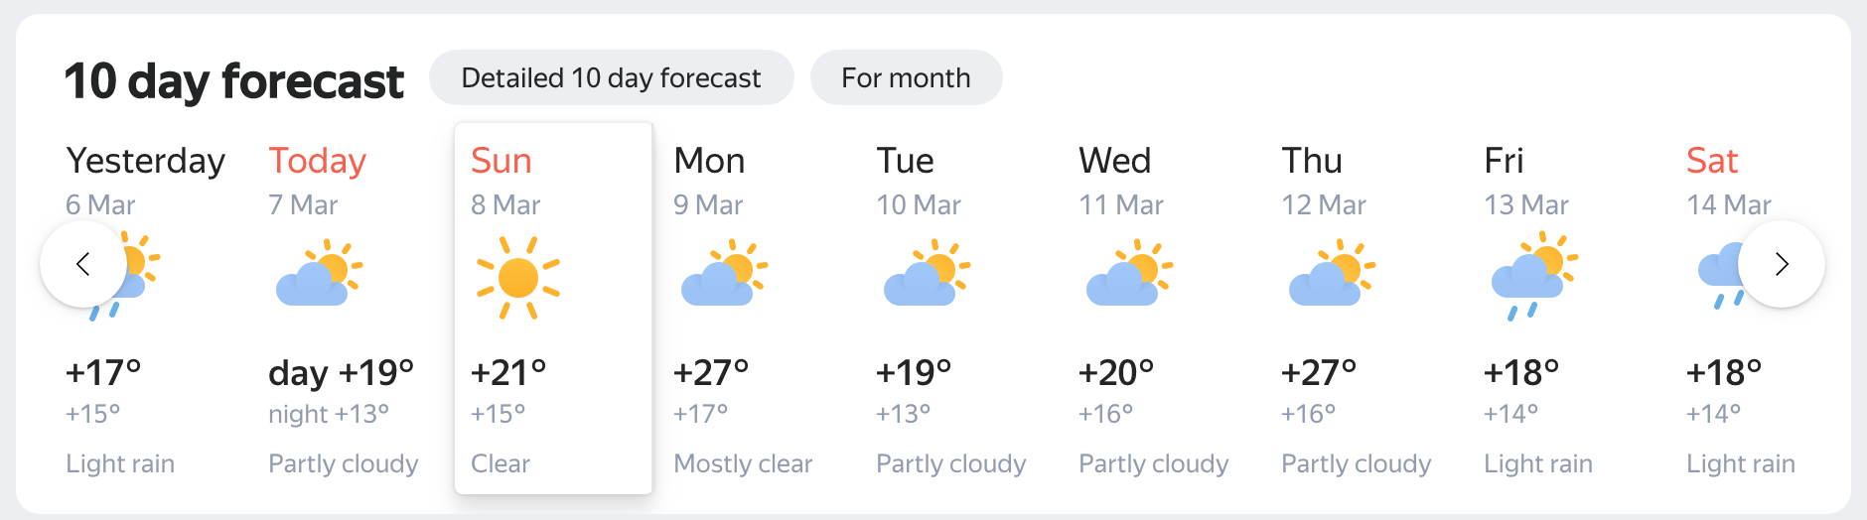
Yandex.Weather
Task?
Cloudiness type and temperature prediction
Task type: multiclassification and regression
Dataset features
Physical weather model output
Neural network output
Online-data from weather stations
Weather historical data
CatBoost features used:
Multiclassification target and RMSE (for temperature)
GPU training
Feature importance analysis
Training process visualization

Slide 12
Yandex.Alice
Task?
Intent classification
Select answer in chit chat mode
Task type: classification, ranking
Dataset features:
Features based on dialog context
Features based on suggested answer
CatBoost features used:
GPU training
Feature importance analysis
Training process visualization
Have you seen the movie “Her”?
Is it very scary?
It is very kind and nice
I should watch it then

Slide 13






CatBoost in the Wild
Recommendations at Netflix
Hotel ranking in Aviasales
Protection against bots in CloudFlare
Particle classification in CERN
Medical research at University of NSW Sydney
Destination prediction in Careem taxi service
ML competitions on Kaggle

Slide 14
Numerical features
Yes
Salary > 30 000
No
Notes:
Категориальные фичи

Slide 15
Categorical features
Engineer
Categorical data
Designer
Occupation
Writer
Manager
HR
Notes:
Категориальные фичи

Slide 16

Categorical features handling
Genre
One-hot encoding
Jazz
Rock
Blues
Statistics based on category
Muse
AC/DC
Tool
Category-based
Label based:
calculated “online”
Greedy search for combinations
Artist
Notes:
For such conversion you could use one-hot-encodings . It is simple and efficient technique, but works only if categorical feature cardinality is low. In reality, many categorical features has a huge number of different values. As a result, it’s hard to build an ensemble of decision trees with help of this technique.
So, to wok with such features one usually makes some feature engineering instead of one hot encoding. And feature engineering is based on problem domain knowledge.

Slide 17
Online features for categories
For every sample “online” feature is calculated using objects with the same category before this one
SDE
1
SDE
1
SDE
0
PR
i
SDE
1
PR
1 + 1 + 0
i
3
Notes:
Категориальные фичи

Slide 18

Text features
BM25
at first i was afraid i was petrified kept thinkin i could never live without you by my side
[0, 1, 2, 3, 4, 2, 3, 5, 6, 7, 2, 8, 9, 10, 11, 12, 13, 14, 15]
Naïve Bayes
Bag-of-Words
…
Dictionary
Notes:
Эмбеддинг,=и используем нескоклько перестановок при подсчете фичей, за счет чего выигрываем по качеству у наивного подхода (невозможно повторить снаружи от CatBoost обучения)
Бывает часто когда рядом с текстом есть некоторое количество фичей, (rotten tomatoes)

Slide 19
Text features examples
Rotten Tomatoes: movie review
Numerical
runtime
box_office – amount of money raised by ticket sales
Categorical
critic - name of reviewer
publisher - journal where the review was published
Text
review - review of a movie, that was written by a critic
genres - list of genres that are suitable for this film
review
One very long, dark ride.
genres
Action and Adventure | Art House and International | Drama | Mystery and Suspense
Notes:
Эмбеддинг,=и используем нескоклько перестановок при подсчете фичей, за счет чего выигрываем по качеству у наивного подхода (невозможно повторить снаружи от CatBoost обучения)
Бывает часто когда рядом с текстом есть некоторое количество фичей, (rotten tomatoes)

Slide 20
Profit from text features
Accuracy on Rotten Tomatoes
Numerical + Caterogical
0.4592
+ BOW
0.4616
+ Online Text Features
0.4714
Notes:
Эмбеддинг,=и используем нескоклько перестановок при подсчете фичей, за счет чего выигрываем по качеству у наивного подхода (невозможно повторить снаружи от CatBoost обучения)
Бывает часто когда рядом с текстом есть некоторое количество фичей, (rotten tomatoes)

Slide 21

Text features in Training
Tokenization
Building dictionaries
Building “online” features
Input text
Tokenizing
Creating dictionary
Applying feature
These computed
estimators
features are passed to training procedure
Notes:
Эмбеддинг,=и используем нескоклько перестановок при подсчете фичей, за счет чего выигрываем по качеству у наивного подхода (невозможно повторить снаружи от CatBoost обучения)
Бывает часто когда рядом с текстом есть некоторое количество фичей, (rotten tomatoes)

Slide 22
Preprocessing stage
Split into words
Process numbers and punctuation
Build letter and word dictionaries
Build ngram dictionaries or BPE
Notes:
Эмбеддинг,=и используем нескоклько перестановок при подсчете фичей, за счет чего выигрываем по качеству у наивного подхода (невозможно повторить снаружи от CatBoost обучения)
Бывает часто когда рядом с текстом есть некоторое количество фичей, (rotten tomatoes)

Slide 23
Bag of Words
Default: word unigrams + word bigrams
For a given dictionary (set of tokens)– is this token present in text?
Dictionary 1:
yesterday, petrified
Dictionary 2:
at+first, i+am
at first i was afraid i was petrified kept thinkin i could never live without you by my side
Feature values:
0,1,1,0
Notes:
Эмбеддинг,=и используем нескоклько перестановок при подсчете фичей, за счет чего выигрываем по качеству у наивного подхода (невозможно повторить снаружи от CatBoost обучения)
Бывает часто когда рядом с текстом есть некоторое количество фичей, (rotten tomatoes)

Slide 24
Naïve Bayes
For every class a new feature P(Class|Text)
P(Class|Text) is replaced with P(Class) * Пi P(wordi | Class)
Most importantly: calculate it “online”
Notes:
Эмбеддинг,=и используем нескоклько перестановок при подсчете фичей, за счет чего выигрываем по качеству у наивного подхода (невозможно повторить снаружи от CatBoost обучения)
Бывает часто когда рядом с текстом есть некоторое количество фичей, (rotten tomatoes)

Slide 25
BM-25 for MultiClass
A new numerical feature for every class of multi-classification
TF – frequency of a word in text
IDF – inverted frequency of a word in a “document”, where
“document” is a concatenation of all texts in this class
Most importantly: calculate it “online”
Notes:
Эмбеддинг,=и используем нескоклько перестановок при подсчете фичей, за счет чего выигрываем по качеству у наивного подхода (невозможно повторить снаружи от CatBoost обучения)
Бывает часто когда рядом с текстом есть некоторое количество фичей, (rotten tomatoes)

Slide 26
Text processing in CatBoost
catboost.Tokenizer
catboost.Dictionary
Advantages:
Fast
Customizable
Production-ready
Can be used with other libraries, including Neural Networks
Notes:
Эмбеддинг,=и используем нескоклько перестановок при подсчете фичей, за счет чего выигрываем по качеству у наивного подхода (невозможно повторить снаружи от CatBoost обучения)
Бывает часто когда рядом с текстом есть некоторое количество фичей, (rotten tomatoes)

Slide 27
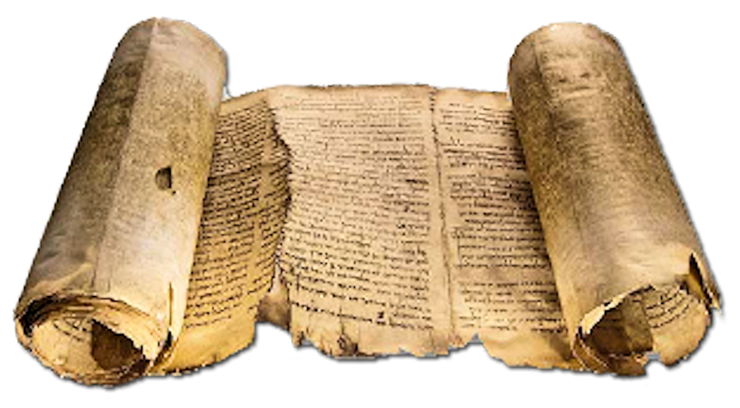
Text features handling
Bag of Words
Light models based on text and labels
Distance for "mean" embedding in class
Distance to NN
…
+
Features based on embeddings
Word2Vec, FastText, etc
Notes:
For such conversion you could use one-hot-encodings . It is simple and efficient technique, but works only if categorical feature cardinality is low. In reality, many categorical features has a huge number of different values. As a result, it’s hard to build an ensemble of decision trees with help of this technique.
So, to wok with such features one usually makes some feature engineering instead of one hot encoding. And feature engineering is based on problem domain knowledge.

Slide 28
Other new features in CatBoost
^
Notes:
Эмбеддинг,=и используем нескоклько перестановок при подсчете фичей, за счет чего выигрываем по качеству у наивного подхода (невозможно повторить снаружи от CatBoost обучения)
Бывает часто когда рядом с текстом есть некоторое количество фичей, (rotten tomatoes)

Slide 29
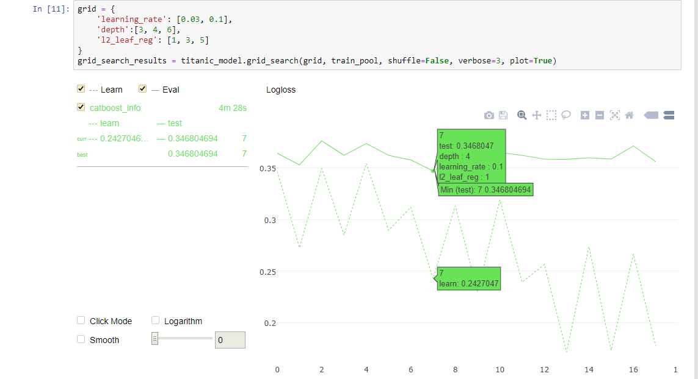
Parameter tuning out of the box

Slide 30
Parameters with effect on quality
Automatic leaning rate selection
Different tree growing strategies
Separate quantization for “golden” features
Improved sampling “MVS”
Exact calculation for leaf values in some modes
^
Notes:
Эмбеддинг,=и используем нескоклько перестановок при подсчете фичей, за счет чего выигрываем по качеству у наивного подхода (невозможно повторить снаружи от CatBoost обучения)
Бывает часто когда рядом с текстом есть некоторое количество фичей, (rotten tomatoes)

Slide 31
Training on Large Data
Local Quantization:
Compressing huge dataset to quantized form
Training on a single machine with 8 Volta GPUs on hundred gigabyte datasets
Most datasets fit to memory of one machine
^
Notes:
Эмбеддинг,=и используем нескоклько перестановок при подсчете фичей, за счет чего выигрываем по качеству у наивного подхода (невозможно повторить снаружи от CatBoost обучения)
Бывает часто когда рядом с текстом есть некоторое количество фичей, (rotten tomatoes)

Slide 32
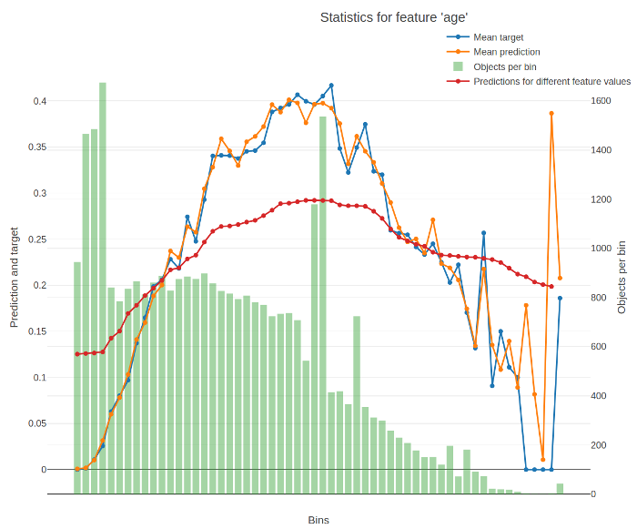
New Model Analysis tools
Per feature model analysis charts
New types of feature importance
Tree visualization
Ranking analysis
^
Notes:
Эмбеддинг,=и используем нескоклько перестановок при подсчете фичей, за счет чего выигрываем по качеству у наивного подхода (невозможно повторить снаружи от CatBoost обучения)
Бывает часто когда рядом с текстом есть некоторое количество фичей, (rotten tomatoes)

Slide 33










Integration in production

Slide 34
Speedups
Huge speedups of preprocessing
Sparse data support
Up to 20x speedups of different modes
Huge speedups for small datasets
^
Notes:
Эмбеддинг,=и используем нескоклько перестановок при подсчете фичей, за счет чего выигрываем по качеству у наивного подхода (невозможно повторить снаружи от CatBoost обучения)
Бывает часто когда рядом с текстом есть некоторое количество фичей, (rotten tomatoes)

Slide 35
Questions?
catboost.ai
github.com/catboost
twitter.com/CatBoostML
t.me/catboost_en, t.me/catboost_ru
ods.ai => slack (40k people community) => tool_catboost chanel
Anna Veronika Dorogush
Head of CatBoost team

